Slide 1

Logic Design
Computer Organization

Slide 2


1. Intro
Lesson 3 Review
Logisim Quick Tour
Logic Gates
Boolean Algebra
Practice
Truth Table
Practice

Slide 3
Range and Precision

Slide 4
Standard Scientific Notation
mantissa
exponent
 |  |  |  |  |  |  |  |  |  | -32 | 16 | 8 | 4 | 2 | 1
0 | 0 | 1 | 1 | 1 | 1 | 1 | 0 | 1 | 0 | 0 | 0 | 1 | 0 | 0 | 0
imaginary point
sign bit
sign bit
Notes:
The mantissa of a floating point number holds the detail of the value of a number, while the exponent is used as a positive or negative factor that can increase or decrease the magnitude of the number. Hence, increasing the number of bits used for the mantissa results in more precision, while increasing the number of bits used for the exponent allows a wider range of available numbers. Consequently, if we need to store precise fractional numbers, we need to have many bits available for the mantissa, while if we want to store very large or very small numbers we need to have many bits available for the exponent.
mantissa => detail of the value of a number represented => increasing bits results in more precision
exponent => increase or decrease the magnitude of the number => increasing bits results in wider range of available numbers

Slide 5
Representing Number Values in Higher Level Language like Java
byte | 8-bit signed two's complement integer (-128 to 127)
short | 16-bit signed two's complement integer (-32,768 to 32767)
int | 32-bit signed two's complement integer (-2³¹ to 2³¹-1)
long | 64-bit signed two's complement integer (-2⁶³ to 2⁶³-1)
float | single-precision 32-bit IEEE 754 floating point (23 bits mantissa + 8 bits exponent)
double | double-precision 64-bit IEEE 754 floating point (52 bits mantissa + 11 bits exponent)
BigDecimal | Complete control over rounding behavior (Use for Currency)
Notes:
byte: The byte data type is an 8-bit signed two's complement integer. It has a minimum value of -128 and a maximum value of 127 (inclusive). The byte data type can be useful for saving memory in large arrays, where the memory savings actually matters. They can also be used in place of int where their limits help to clarify your code; the fact that a variable's range is limited can serve as a form of documentation.
short: The short data type is a 16-bit signed two's complement integer. It has a minimum value of -32,768 and a maximum value of 32,767 (inclusive). As with byte, the same guidelines apply: you can use a short to save memory in large arrays, in situations where the memory savings actually matters.
int: By default, the int data type is a 32-bit signed two's complement integer, which has a minimum value of -2³¹ and a maximum value of 2³¹-1. In Java SE 8 and later, you can use the int data type to represent an unsigned 32-bit integer, which has a minimum value of 0 and a maximum value of 2³²-1. Use the Integer class to use int data type as an unsigned integer. See the section The Number Classes for more information. Static methods like compareUnsigned, divideUnsigned etc have been added to the Integer class to support the arithmetic operations for unsigned integers.
long: The long data type is a 64-bit two's complement integer. The signed long has a minimum value of -2⁶³ and a maximum value of 2⁶³-1. In Java SE 8 and later, you can use the long data type to represent an unsigned 64-bit long, which has a minimum value of 0 and a maximum value of 2⁶⁴-1. Use this data type when you need a range of values wider than those provided by int. The Long class also contains methods like compareUnsigned, divideUnsigned etc to support arithmetic operations for unsigned long.
float: The float data type is a single-precision 32-bit IEEE 754 floating point. Its range of values is beyond the scope of this discussion, but is specified in the Floating-Point Types, Formats, and Values section of the Java Language Specification. As with the recommendations for byte and short, use a float (instead of double) if you need to save memory in large arrays of floating point numbers. This data type should never be used for precise values, such as currency. For that, you will need to use the java.math.BigDecimal class instead. Numbers and Strings covers BigDecimal and other useful classes provided by the Java platform.
double: The double data type is a double-precision 64-bit IEEE 754 floating point. Its range of values is beyond the scope of this discussion, but is specified in the Floating-Point Types, Formats, and Values section of the Java Language Specification. For decimal values, this data type is generally the default choice. As mentioned above, this data type should never be used for precise values, such as currency.

Slide 6
Range and Precision - Summary
For a given sized register, the number of values that can be represented is limited
Greater precision comes at the expense of range
Greater range comes at the expense of precision
Accuracy often depends on precision, but not always
There will always be values that can’t be represented accurately in binary

Slide 7
Byte Order (Endianness)
Notes:
In computing, endianness is the order or sequence of bytes of a word of digital data in computer memory. Endianness is primarily expressed as big-endian (BE) or little-endian (LE). A big-endian system stores the most significant byte of a word at the smallest memory address and the least significant byte at the largest. A little-endian system, in contrast, stores the least-significant byte at the smallest address.
Endianness may also be used to describe the order in which the bits are transmitted over a communication channel, e.g., big-endian in a communications channel transmits the most significant bits first.[1] Bit-endianness is seldom used in other contexts.

Slide 8
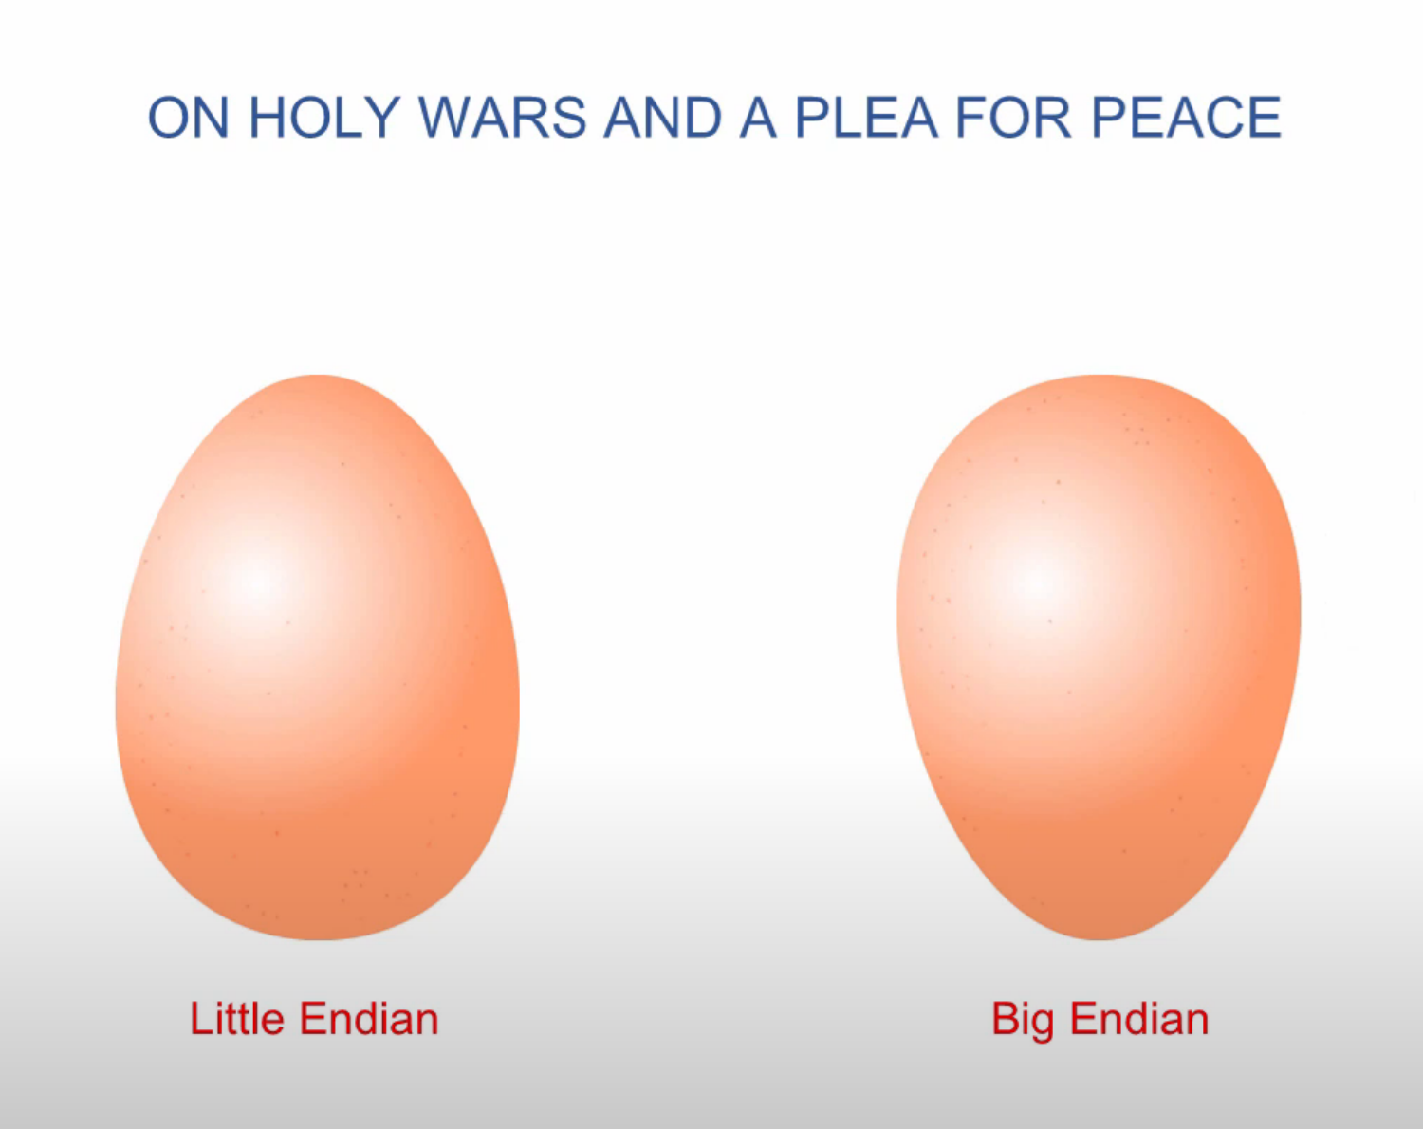
Notes:
Many historical and extant processors use a big-endian memory representation, either exclusively or as a design option. Big-endian memory representation is commonly referred to as network order, as used in the Internet protocol suite. Other processor types use little-endian memory representation; others use yet another scheme called "middle-endian", "mixed-endian" or "PDP-11-endian".
The IBM System/360 uses big-endian byte order, as do its successors System/370, ESA/390, and z/Architecture. The PDP-10 also uses big-endian addressing for byte-oriented instructions. The IBM Series/1 minicomputer also use big-endian byte order.
Dealing with data of different endianness is sometimes termed the NUXI problem.^{[10]} This terminology alludes to the byte order conflicts encountered while adapting UNIX, which ran on the mixed-endian PDP-11, to a big-endian IBM Series/1 computer. Unix was one of the first systems to allow the same code to be compiled for platforms with different internal representations. One of the first programs converted was supposed to print out Unix, but on the Series/1 it printed nUxi instead.^{[11]}
The Datapoint 2200 uses simple bit-serial logic with little-endian to facilitate carry propagation. When Intel developed the 8008 microprocessor for Datapoint, they used little-endian for compatibility. However, as Intel was unable to deliver the 8008 in time, Datapoint used a medium scale integration equivalent, but the little-endianness was retained in most Intel designs, including the MCS-48 and the 8086 and its x86 successors.^{[12][13]} The DEC Alpha, Atmel AVR, VAX, the MOS Technology 6502 family (including Western Design Center 65802 and 65C816), the Zilog Z80 (including Z180 and eZ80), the Altera Nios II, and many other processors and processor families are also little-endian.
The Motorola 6800 / 6801, the 6809 and the 68000 series of processors used the big-endian format.
The Intel 8051, contrary to other Intel processors, expects 16-bit addresses for LJMP and LCALL in big-endian format; however, xCALL instructions store the return address onto the stack in little-endian format.^{[14]}
SPARC historically used big-endian until version 9, which is bi-endian; similarly early IBM POWER processors were big-endian, but the PowerPC and Power ISA descendants are now bi-endian. The ARM architecture was little-endian before version 3 when it became bi-endian.
Current architectures[edit]
The Intel x86 and AMD64 / x86-64 series of processors use the little-endian format. Other instruction set architectures that follow this convention, allowing only little-endian mode, include Nios II, Andes Technology NDS32, and Qualcomm Hexagon.
Some instruction set architectures allow running software of either endianness on a bi-endian architecture. This includes ARM AArch64, C-Sky, Power ISA, and RISC-V.
Solely big-endian architectures include the IBM z/Architecture, Freescale ColdFire (which is Motorola 68000 series-based), Atmel AVR32, and OpenRISC. The IBM AIX and Oracle Solaris operating systems on bi-endian Power ISA and SPARC run in big-endian mode; some distributions of Linux on Power have moved to little-endian mode.

Slide 9
Decimal Positional Notation
Most significant number on the left.
Biggest part of the number that is the BIG END
1000 | 100 | 10 | 1
1 | 0 | 2 | 4
1 | 10 | 100 | 1000
4 | 2 | 0 | 1
Most significant number on the right.
Littlest part of the number, that is the LITTLE END

Slide 10
Binary Positional Notation
Most significant number on the left.
Biggest part of the number that is the BIG ENDIAN
8 | 4 | 2 | 1
1 | 1 | 1 | 0
1 | 2 | 4 | 8
0 | 1 | 1 | 1
Most significant number on the right.
Littlest part of the number, that is the LITTLE ENDIAN

Slide 11
Binary Positional Notation
128 | 64 | 32 | 16 | 8 | 4 | 2 | 1
0 | 0 | 1 | 0 | 1 | 1 | 1 | 0
0 | 1 | 0 | 0 | 1 | 1 | 1 | 0
0 | 0 | 0 | 1 | 0 | 1 | 0 | 0
1 | 1 | 1 | 0 | 0 | 0 | 1 | 0
1 | 0 | 1 | 0 | 0 | 1 | 0 | 0

Slide 12
Hexadecimal
Notes:
In mathematics and computing, the hexadecimal (also base 16 or hex) numeral system is a positional numeral system that represents numbers using a radix (base) of 16. Unlike the common way of representing numbers using 10 symbols, hexadecimal uses 16 distinct symbols, most often the symbols "0"–"9" to represent values 0 to 9, and "A"–"F" (or alternatively "a"–"f") to represent values 10 to 15.
Hexadecimal numerals are widely used by computer system designers and programmers because they provide a human-friendly representation of binary-coded values. Each hexadecimal digit represents four bits (binary digits), also known as a nibble (or nybble), which is 1/2 of a byte. For example, a single byte can have values ranging from 00000000 to 11111111 in binary form, which can be conveniently represented as 00 to FF in hexadecimal.

Slide 13
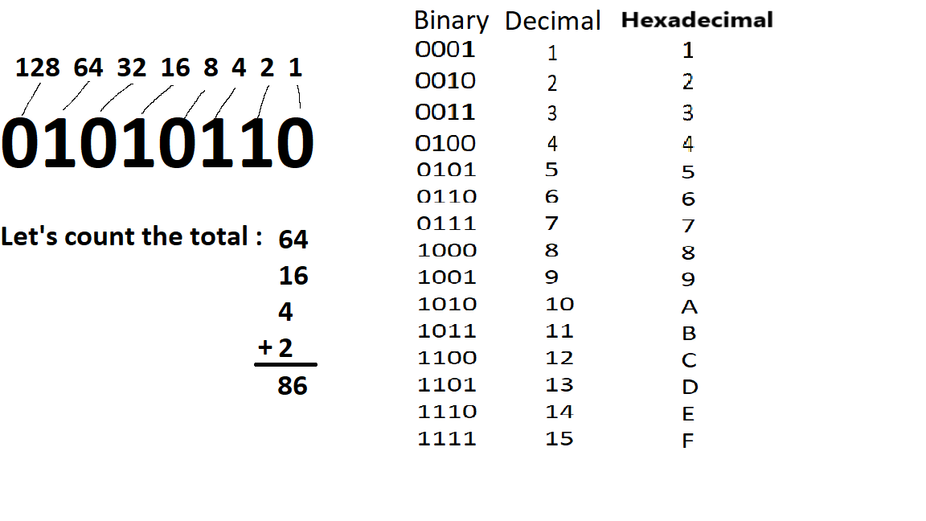

Slide 14
Logic Gates
Notes:
A logic gate is an idealized model of computation or physical electronic device implementing a Boolean function, a logical operation performed on one or more binary inputs that produces a single binary output.
Logic gates are primarily implemented using diodes or transistors acting as electronic switches, but can also be constructed using vacuum tubes, electromagnetic relays (relay logic), fluidic logic, pneumatic logic, optics, molecules, or even mechanical elements. With amplification, logic gates can be cascaded in the same way that Boolean functions can be composed, allowing the construction of a physical model of all of Boolean logic, and therefore, all of the algorithms and mathematics that can be described with Boolean logic.

Slide 15
Digital Design Basics
Two voltage levels – high and low (1 and 0, true and false)
Hence, the use of binary arithmetic/logic in all computers
A transistor is a 3-terminal device that acts as a switch
V
V
0
V
V
Conducting
0
Non-conducting
0
0
Notes:
Since AND is commutative and associative, an AND gate can have multiple inputs, with the output equal to the AND of all the inputs.
The same is true of OR.

Slide 16
Logic Block
A logic block has a number of binary inputs and produces
a number of binary outputs – the simplest logic block is
composed of a few transistors
A logic block is termed combinational if the output is only
a function of the inputs
A logic block is termed sequential if the block has some
internal memory (state) that also influences the output
A basic logic block is termed a gate (AND, OR, NOT, etc.)
Notes:
Since AND is commutative and associative, an AND gate can have multiple inputs, with the output equal to the AND of all the inputs.
The same is true of OR.

Slide 17
Truth Table
A table of all possible inputs and the associated outputs for a particular circuit
All combinational logic can be completely described using a truth table
Non-zero output truth tables only list the inputs that result in non-zero outputs
Text example: for all values of A, B, and C, let D be true if at least one input is true, let E be true if exactly two inputs are true, and let F be true only if all three inputs are true.
Notes:
Since AND is commutative and associative, an AND gate can have multiple inputs, with the output equal to the AND of all the inputs.
The same is true of OR.

Slide 18
Boolean Algebra
binary OR is written +
logical sum
result is 1 if at least one variable is 1
binary AND is written *
logical product
result is 1 only if both variables are 1
unary NOT is written `A
Notes:
Boolean algebra is the category of algebra in which the variable’s values are the truth values, true and false, ordinarily denoted 1 and 0 respectively. It is used to analyze and simplify digital circuits or digital gates.
A mathematician, named George Boole had developed this algebra in 1854. The variables used in this algebra are also called as Boolean variables.

Slide 19
Gate
A gate is a device that implements basic logic functions, such as AND or OR.
Logic blocks are built from gates that implement basic logic functions.
The logical function NOT is implemented with an inverter that always has a single input.
Notes:
Since AND is commutative and associative, an AND gate can have multiple inputs, with the output equal to the AND of all the inputs.
The same is true of OR.

Slide 20
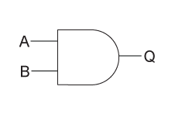
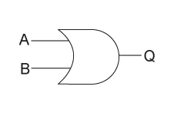
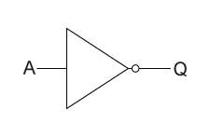
Gate
AND
OR
NOT (inverter)
Notes:
Tour Logisim functionality
Wired each gate (AND, OR, NOT)
Test result
Build Truth Table

Slide 21
Practice

Slide 22
Build the Truth Table
1) for all values of A and B, let C be true if B is true.
2) for all values of A, B, and C, let D be true if B is true. Let E be true if exactly A and C true

Slide 23
NAND and NOR Gates
In fact, all logic functions can be constructed with only a single gate type, if that gate is inverting.
The two common inverting gates are called NOR and NAND and correspond to inverted OR and AND gates, respectively.
NOR and NAND gates are called universal, since any logic function can be built using this one gate type.
Notes:
Since AND is commutative and associative, an AND gate can have multiple inputs, with the output equal to the AND of all the inputs.
The same is true of OR.

Slide 24
Types of Combinational Logic
Arithmetic and logical
Adders, Subtractors, Multipliers, Comparators
Data handling
Multiplexers, Demultiplexers, encoders, decoders

Slide 25
2. End
HOMEWORK ***
Collaborate on Slack
Logic Gates, Truth Table, Boolean Algebra
Complete practice problems
Download Logisim-evolution
Test that you are able to run on your computer.

